Slide 1
CS2S562
Secure Software Development
Coursework 1 Guidance

Slide 2
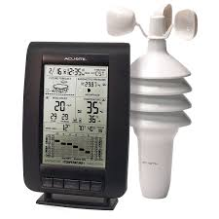
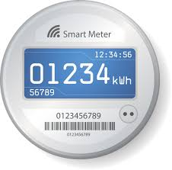
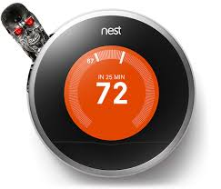
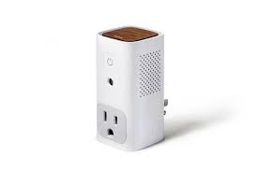
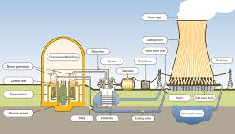
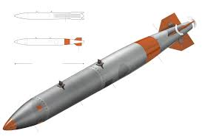
General
i.e. don’t build a real one, just a pretend one
The Task
  “Design and implement a piece of Console application software in to simulate a smart device that could belong to The Internet of Things.”
  Every student a different device. Choice up to you.
  Examples:

Slide 3
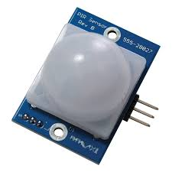
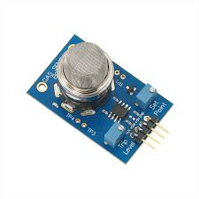
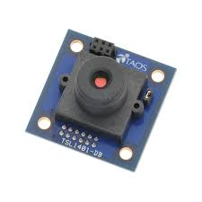
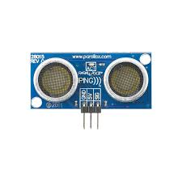
Functional Requirements (1 of 7)
3 simulated input sensors
  e.g weather station temperature, air pressure, wind speed sensors
  Could be implemented using random number generators or read from internet using real weather data
  Sensor output (as a trusted component) needs to be sanitised (see Formatted I/O, week 4). E.g. check that air pressure is within possible limits.
  Ultrasound proximity Infrared Smoke detector camera

Slide 4
Functional Requirements (2 of 7)
1 of the sensor outputs must require some processing
  e.g weather station height above sea level adjusts air pressure to normal zero above sea level.
  This requires the use of safe functions (see safe calculations, week 2, integer and floating point security), e.g. using:
  uint_16 normPress = safeAdjust(sensorPress, heightAboveSeaLevel);

Slide 5
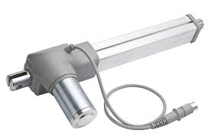
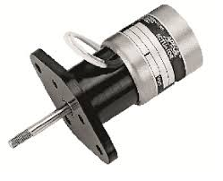
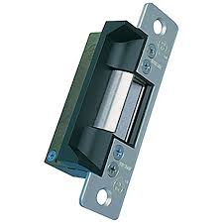
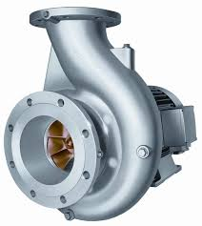
Functional Requirements (3 of 7)
At least 1 sensor must cause an action to be performed by an Actuator
  e.g weather station: wind sensor rotor blades put into neutral position during heavy storm
  Since we simulate the device the only action could be a text output:
  “Storm damage danger! Putting wind sensor blades into neutral”
  Linear motor stepper motor door lock release pump

Slide 6
Functional Requirements (4 of 7)
Sensor data AND internal device state must be stored and be retrievable
  e.g weather station temperature, air pressure, wind speed sensors stored every 10 minutes or so
  The same for device state: voltage, internal temperature, any faults, …
  Retrieval e.g. via user input:
  “Show data of how many past hours: ___”
  All user input needs to be canonicalised, normalised, sanitised and validated (see Formatted I/O, week 4)
  Implementation using safe File I/O (see File I/O, week 5), e.g use of the “triple lock” method.

Slide 7
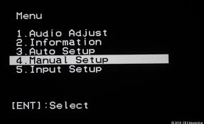
Functional Requirements (5 of 7)
Build a User Interface
  Shows data / provides the service
  Allows management of the device, e.g.:
    initial setup (by user)
    clearing of error log (by manufacturer)
    Setting of access levels / permissions (by administrator)
Different roles with different access levels

Slide 8
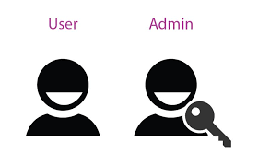
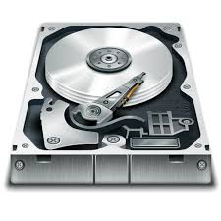
Functional Requirements (6&7 of 7)
Roles have only access to functions where they have permission for
  e.g.: users: initial setup, recall historic data, …
  manufacturer: everything
  administrator: all user functions plus ….
Permissions for users are determined by the administrator
  To be store persistently,
  not just for single session

Slide 9


Non- Functional Requirements
(1 of 2)
Demonstrate at least these best practices
    Signed and unsigned integers and calculations with them
    Strings and char[ ] (in a safe manner)
    File I/O
    User keyboard I/O
    Pointers
  This means you may occasionally
  have to “artificially” (without a real need
  other than showing your skills) use the above.

Slide 10
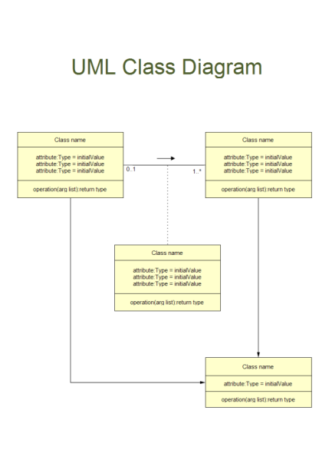
Non- Functional Requirements
(2 of 2)
Program must be designed using 2 Secure Patterns
  To be taught in the next couple of weeks
  Example Patterns (for details see ‘Notes’ at end of CW document):
    Secure Logger (for Funct.Requ. 4: store & retrieve sensor data)
    Access Control (for Funct.Requs. 6&7: access by different roles)
  Document the Design in a UML Class
  Diagram (also to be taught in the next couple of weeks)

Slide 11
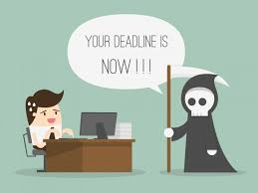

Deadline
(You’ve got time)
February 22, 2019
  Zip up:
    The entire Visual Studio project folder
    The UML class diagram
    A short document detailing where exactly in your code you have applied which secure coding principle (e.g. “secure unsigned int addition is demonstrated in SecureMaths.cpp function SecureAddUint16( … ) lines 52 to 75” ”
  Submit to Blackboard, link under ‘Assessment’
  Submission must be completed at 23:59
  (upload to BB may take 10 minutes due
  to large file size – bear that in mind)

